Slide 1
以CNN實現手語辨識
組員:林政宏
報告人:王樸、吳承威

Slide 2
introduction
大部分非聾啞人士對手語不了解,造成聾啞人士與非聾啞人士的溝通障礙
Notes:
很少有人能理解手語,造成聾啞人士和非聾啞人士溝通的障礙。此外書面交流非常麻煩，因為聾啞人士普遍寫作能力較差。況且書寫溝通是是非常緩慢的,無法即時的應對當下的狀況。因此我們決定使用卷積式神經網路(Convolutional Neural Network,CNN)做一個手語辨識的系統,用來將美國手語(American Sign Language,ASL)轉成文字,增進非聾啞人士與聾啞人士的溝通。

Slide 3
Model
純CNN
YOLOv3

Slide 4
Convolutional neural network (CNN)

Slide 5

feature extractor
classification

Slide 6
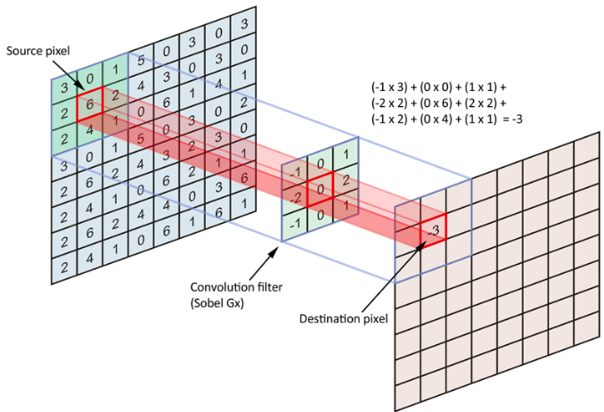
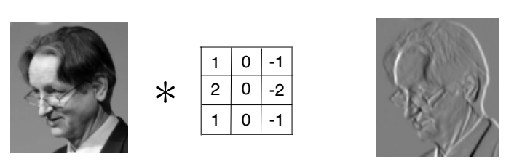
convolutional layer

Slide 7
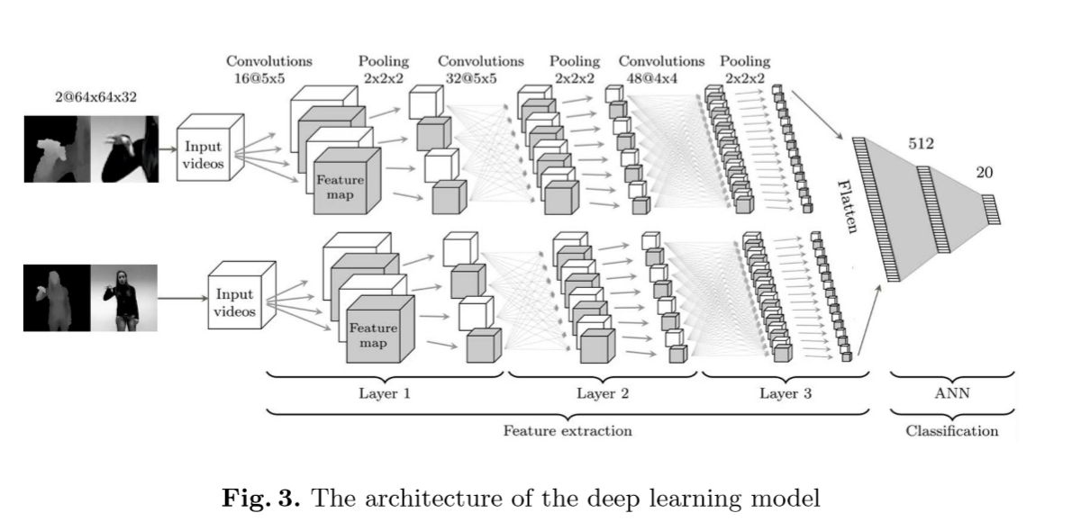
CNN architecture

Slide 8
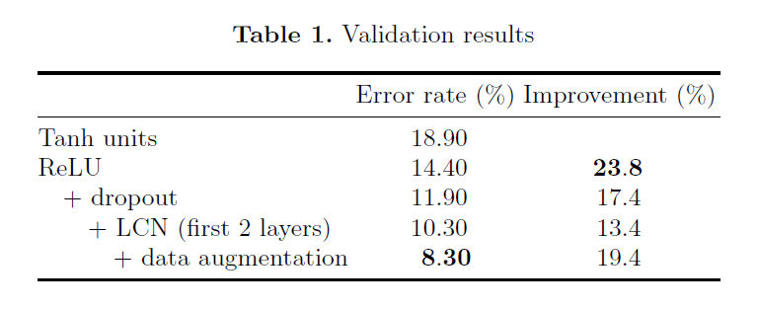
Notes:
ChaLearn Looking at People 2014 [5] (CLAP14) challenge in this work
This dataset consists of 20 different Italian gestures, performed by 27 users with variations in
surroundings, clothing, lighting and gesture movement
6600 gestures
4600 for the training set and 2000 for the validation set.
test set for this work and consists of 3543 samples
The
users and backgrounds in the validation set are not contained in the training
set. The users and backgrounds in the test set can occur in the training and the
validation set.
tan unit -activation function
LCN(local contrast normalization)

Slide 9
you only look once
(yolo)

Slide 10
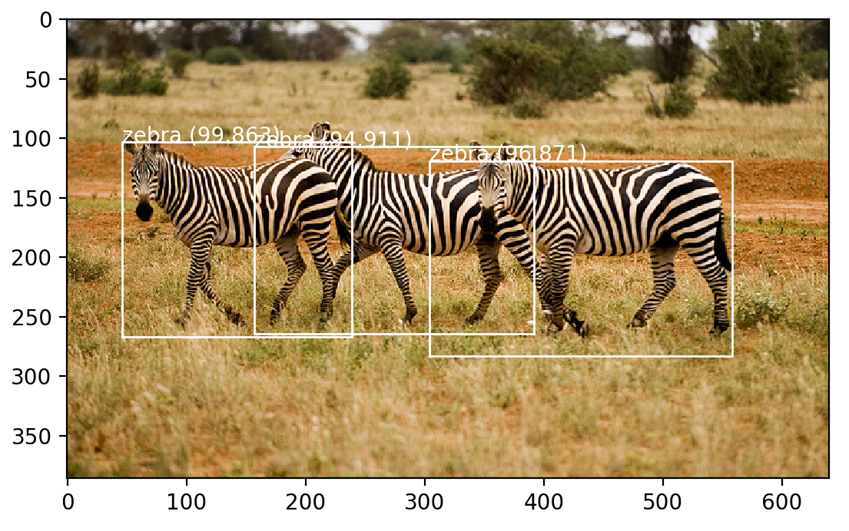
YOLOv3

Slide 11
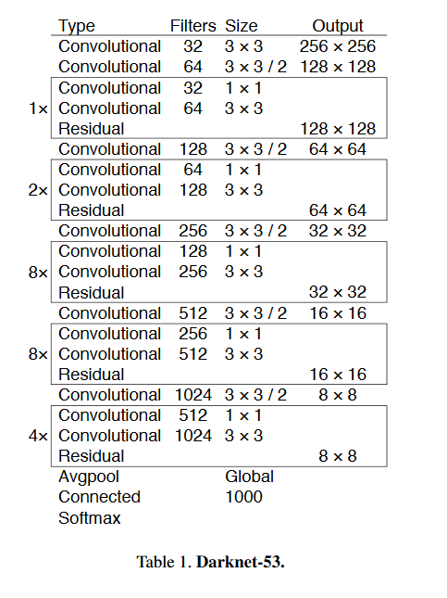
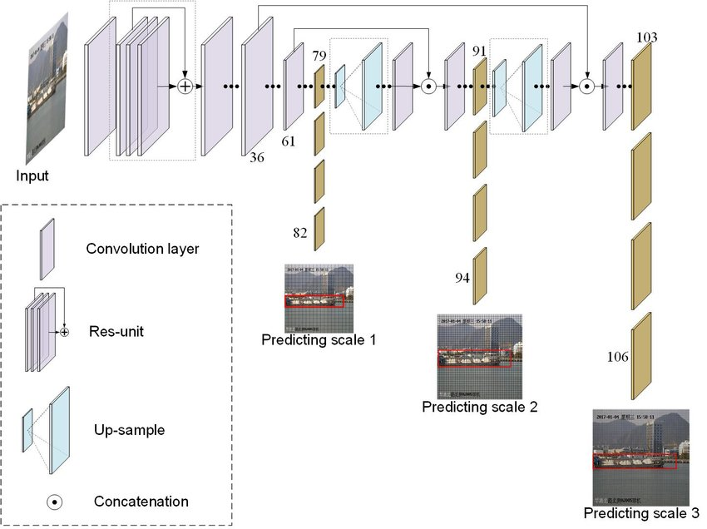
yolov3 architecture
DSSD

Slide 12
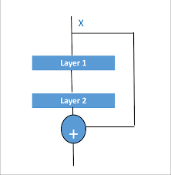
residual layer
Notes:
防止vanish gradient problem-前面的层比后面的层梯度变化更小，故变化更慢，从而引起了梯度消失问题。

Slide 13
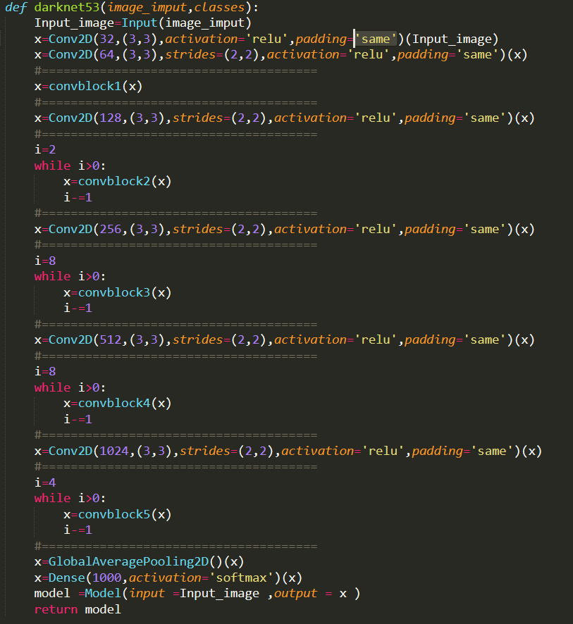
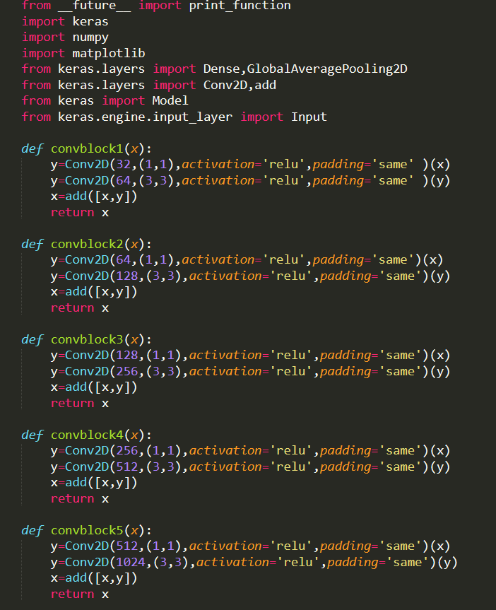

Slide 14
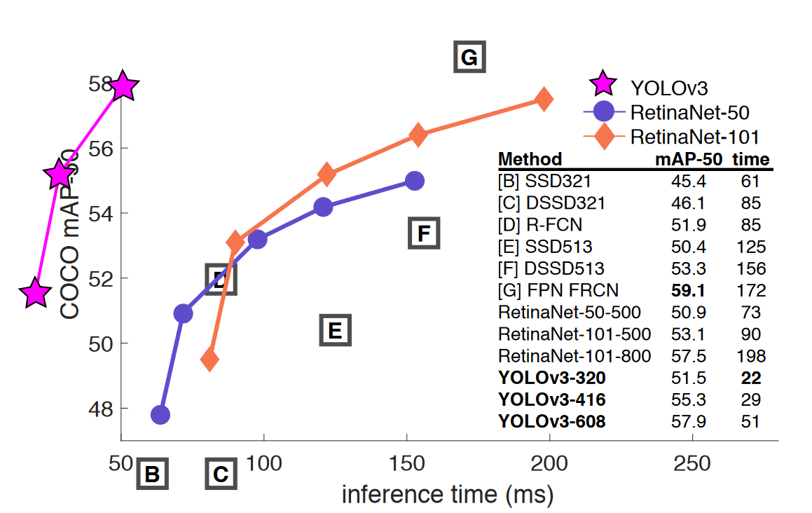

Slide 15
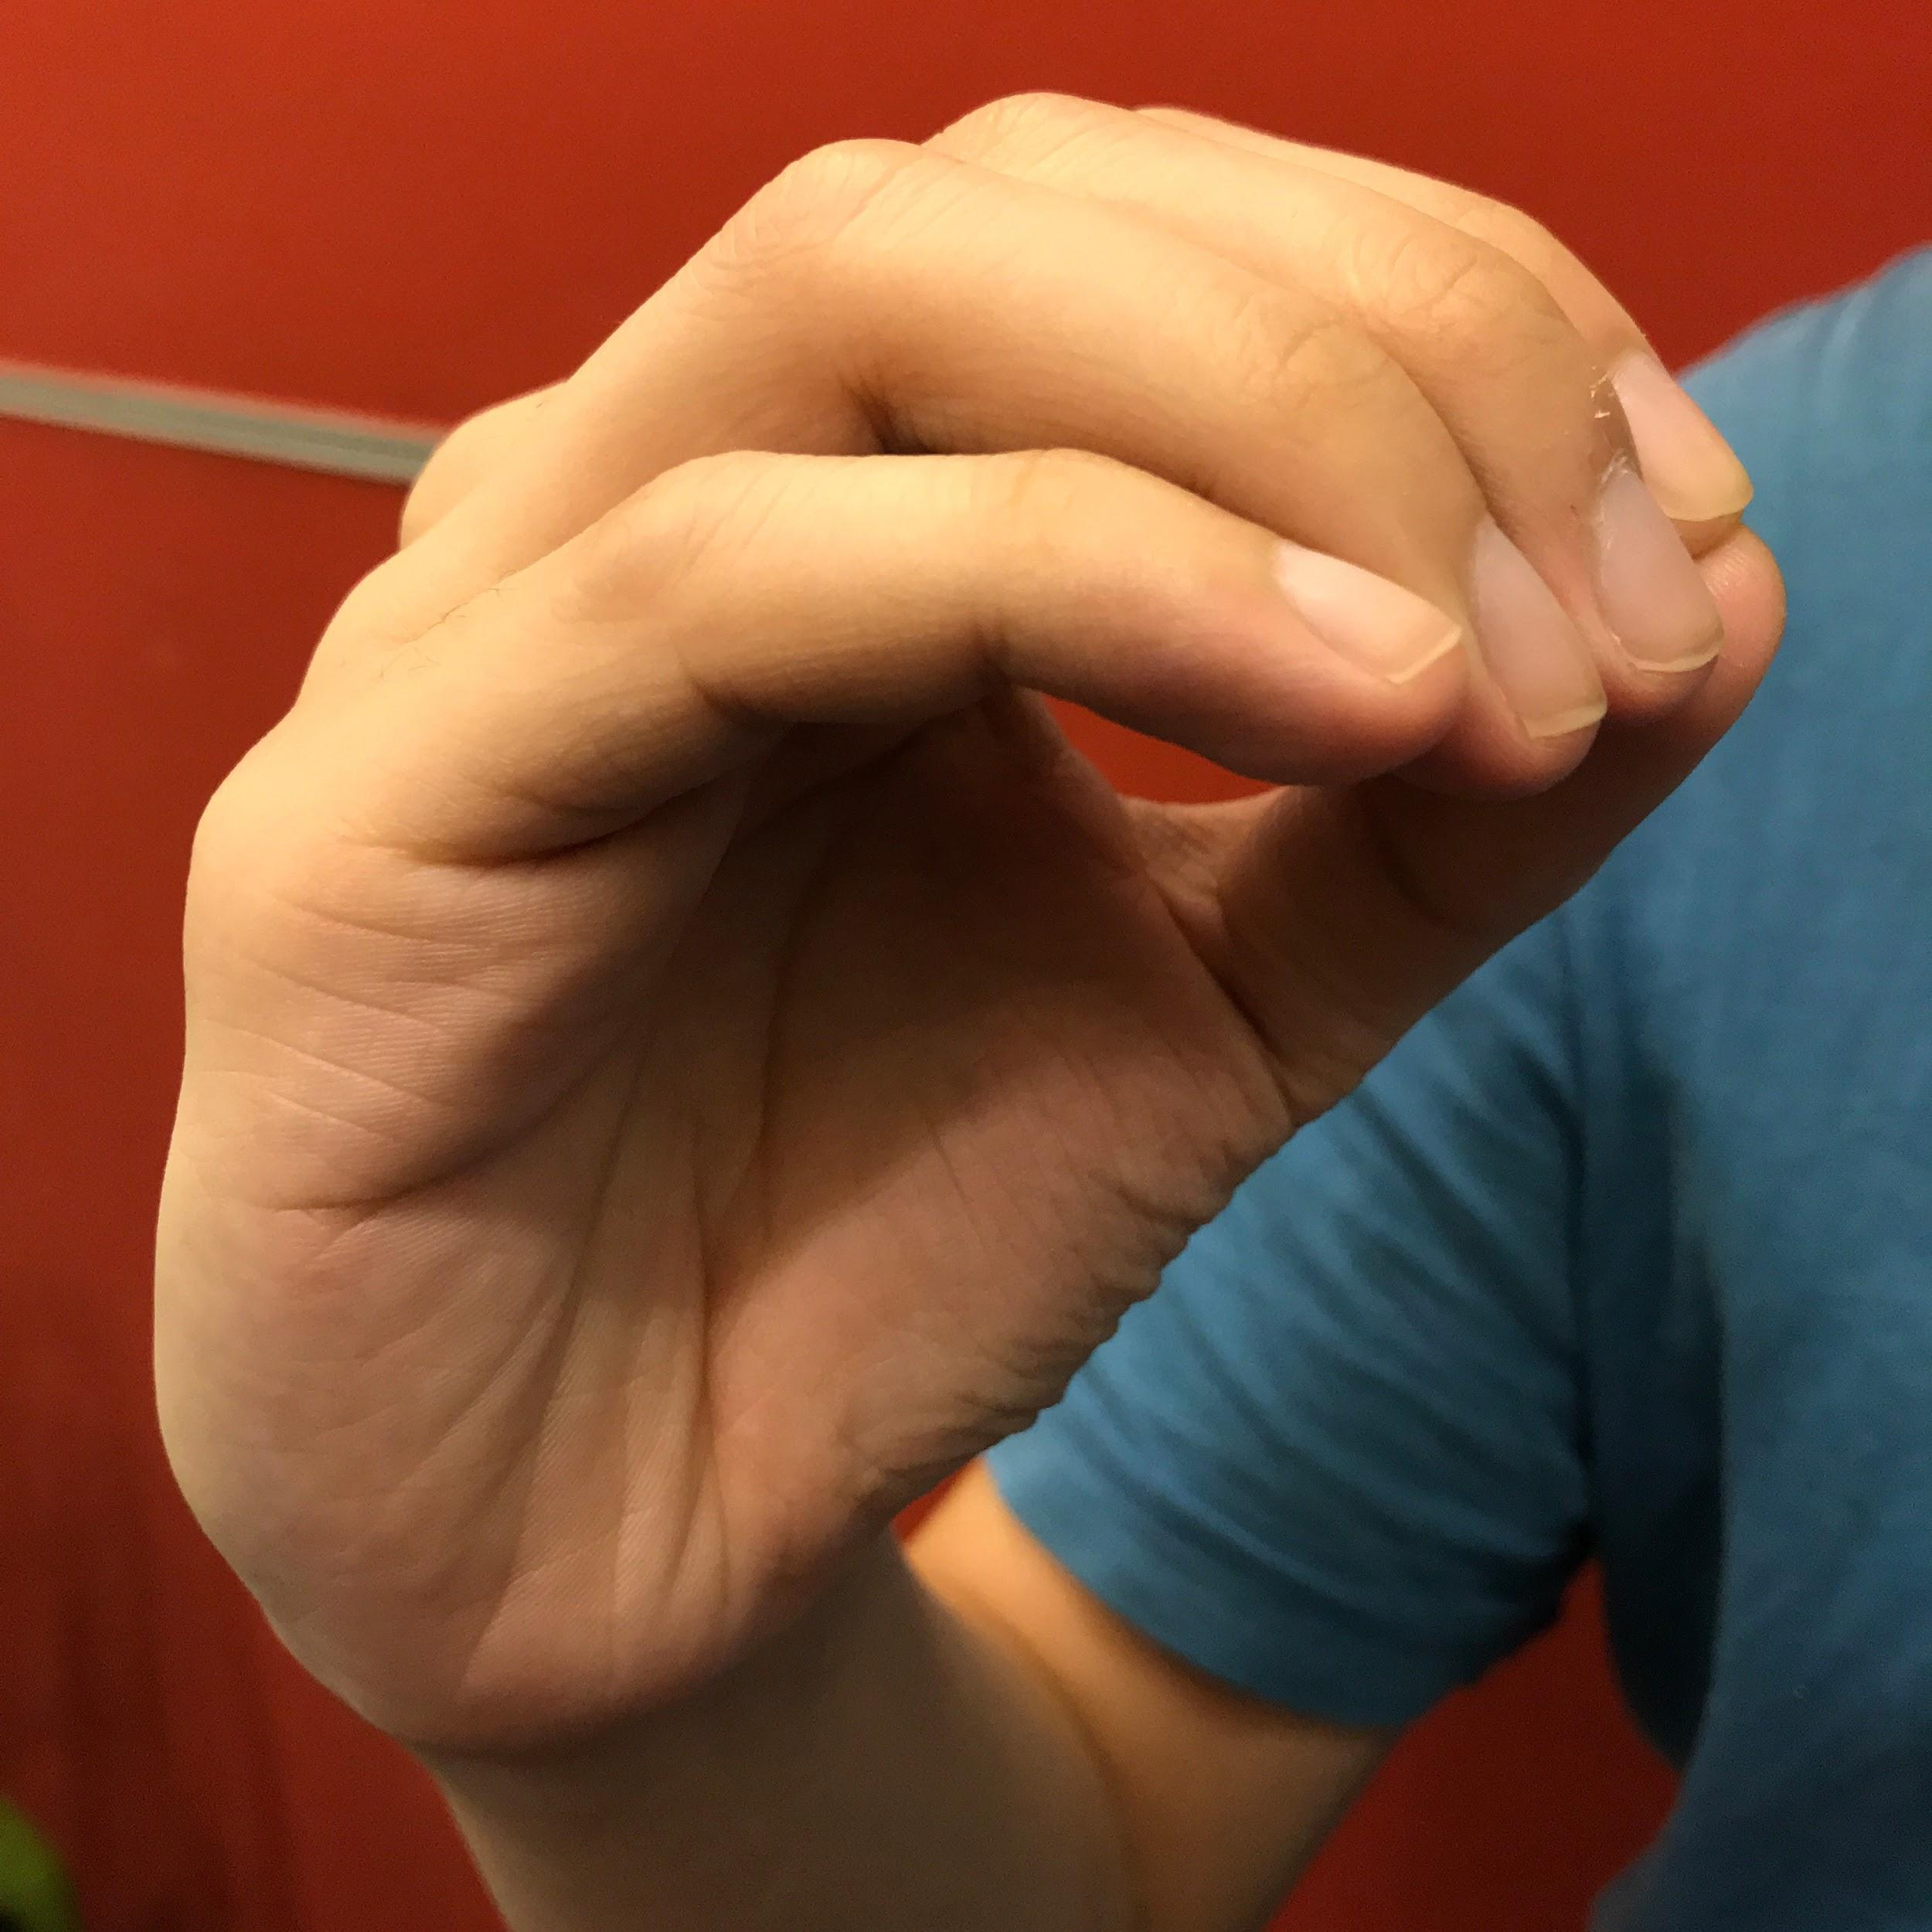
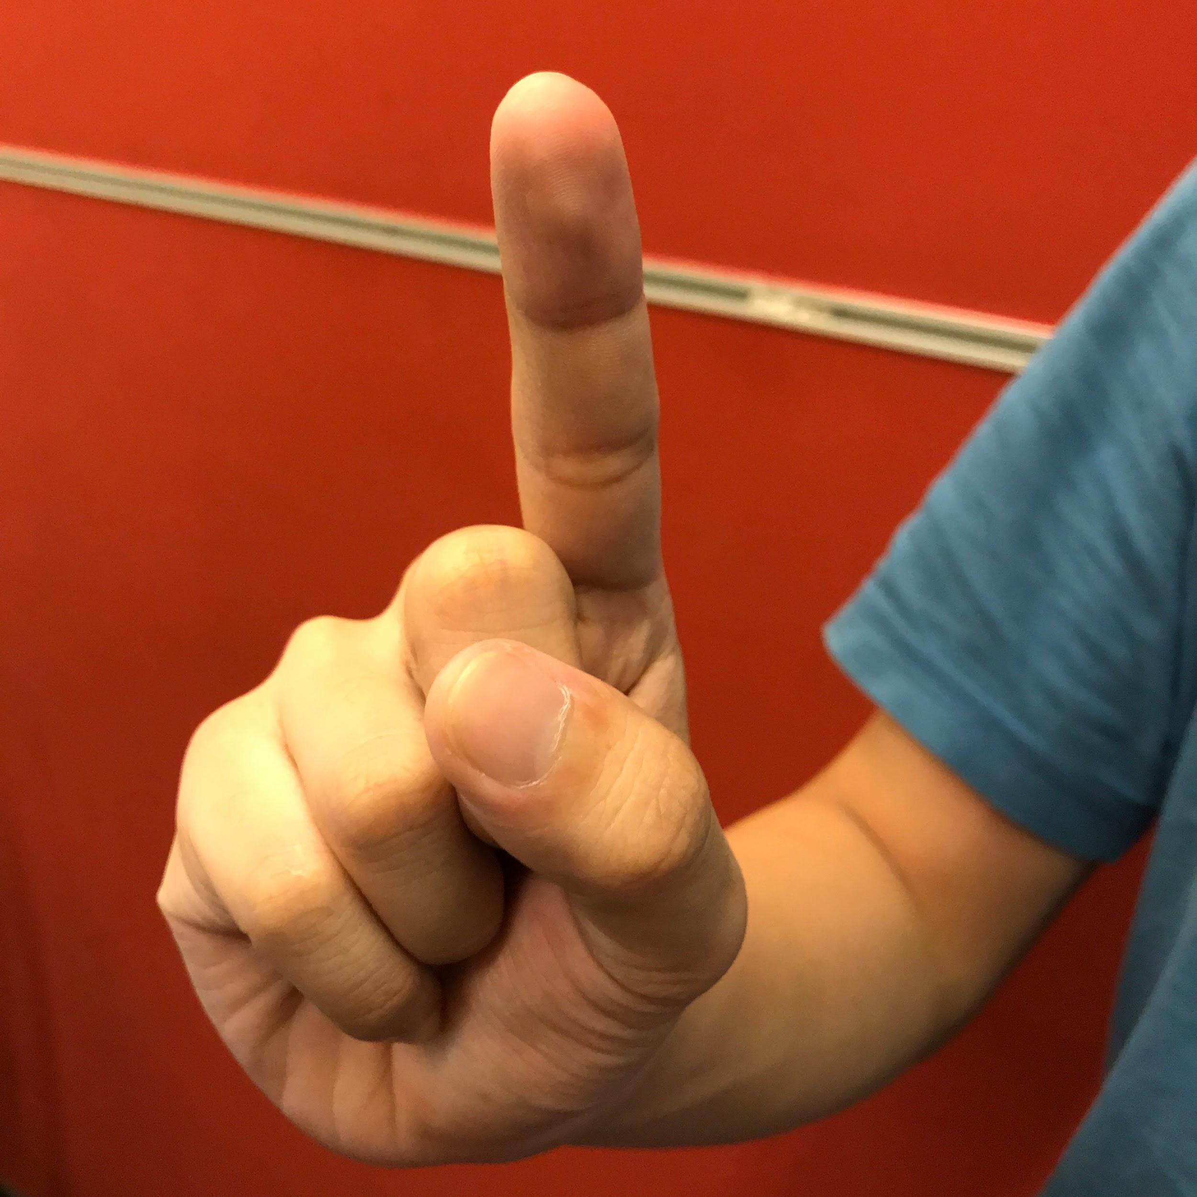
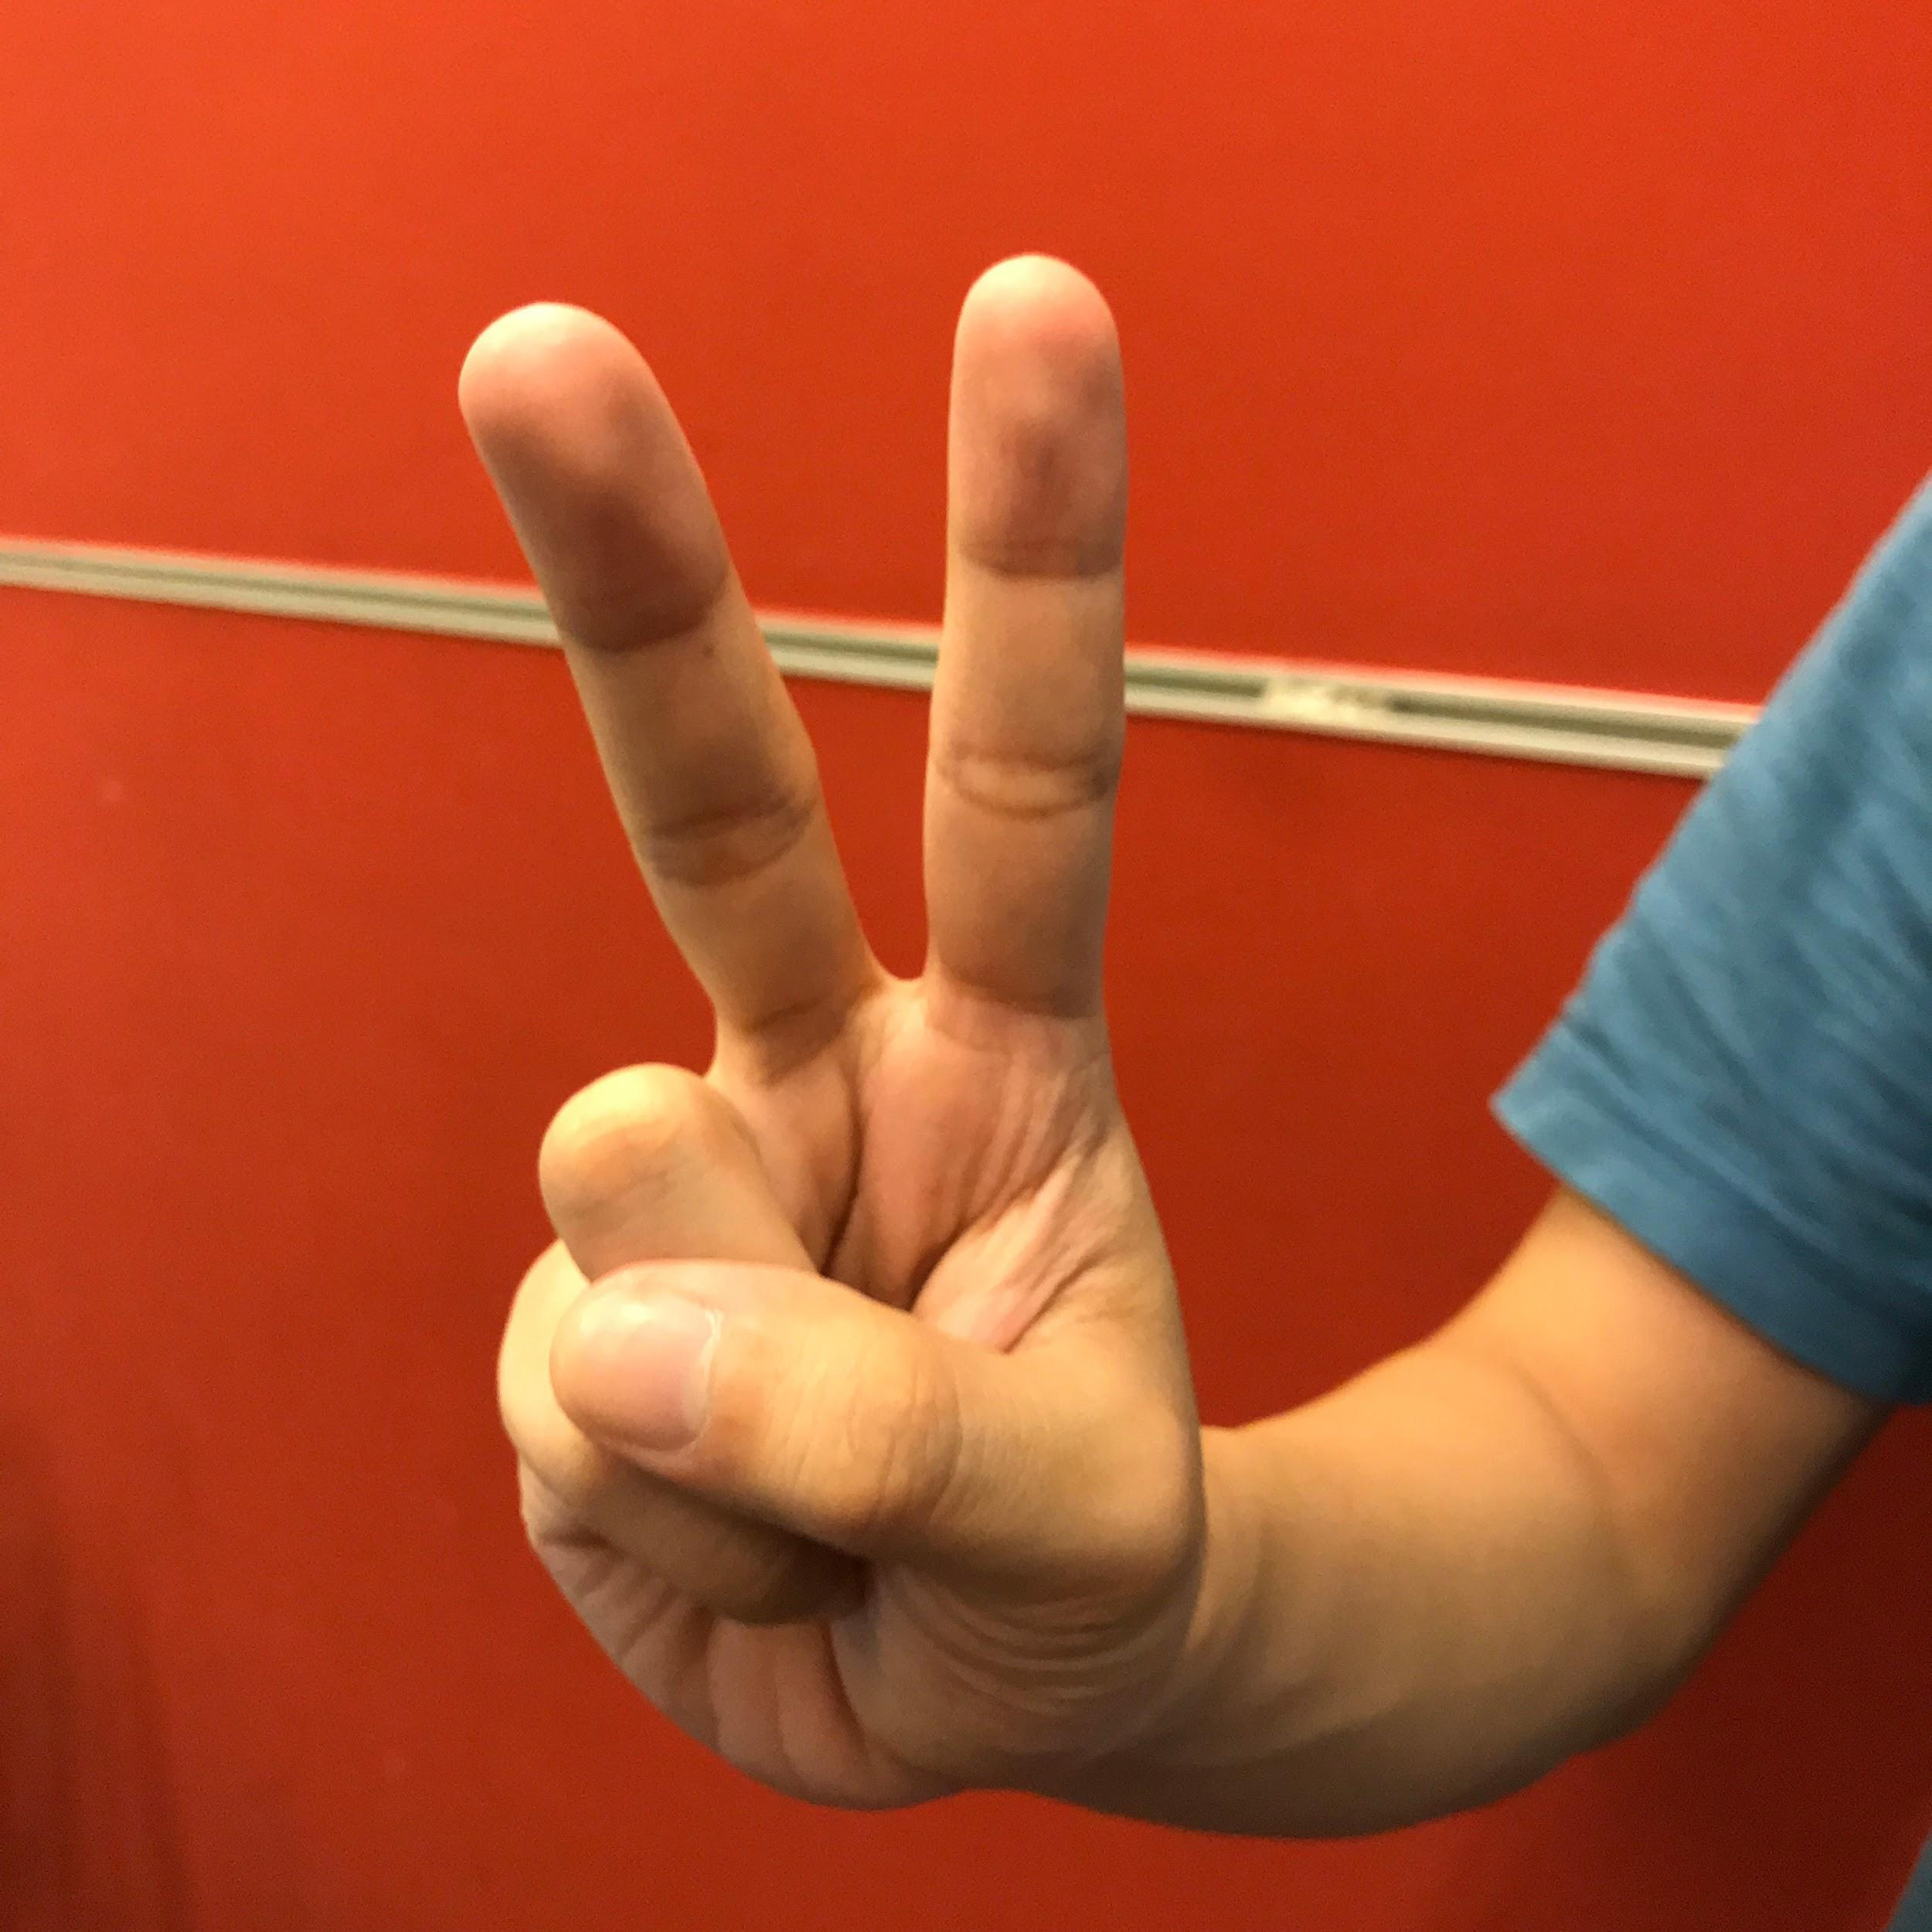
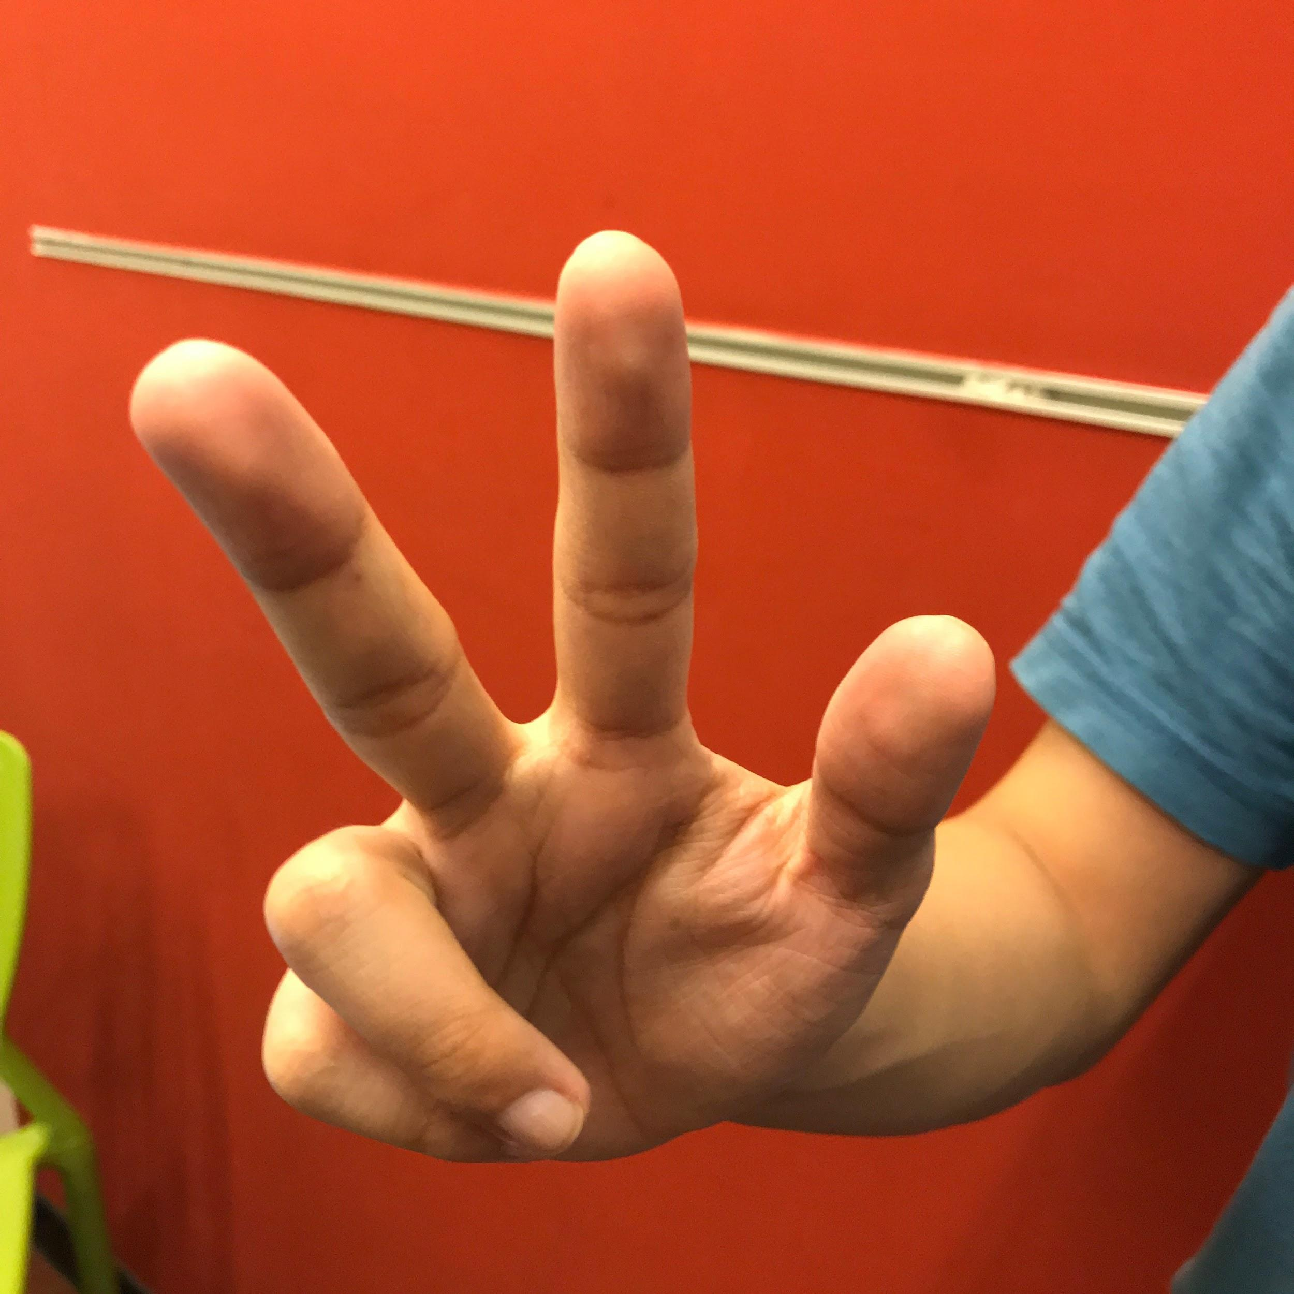
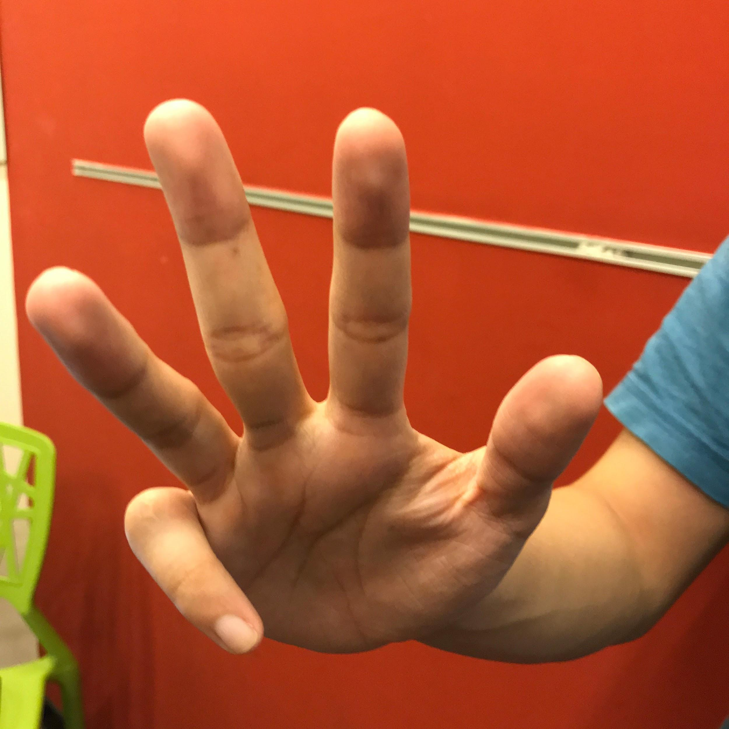
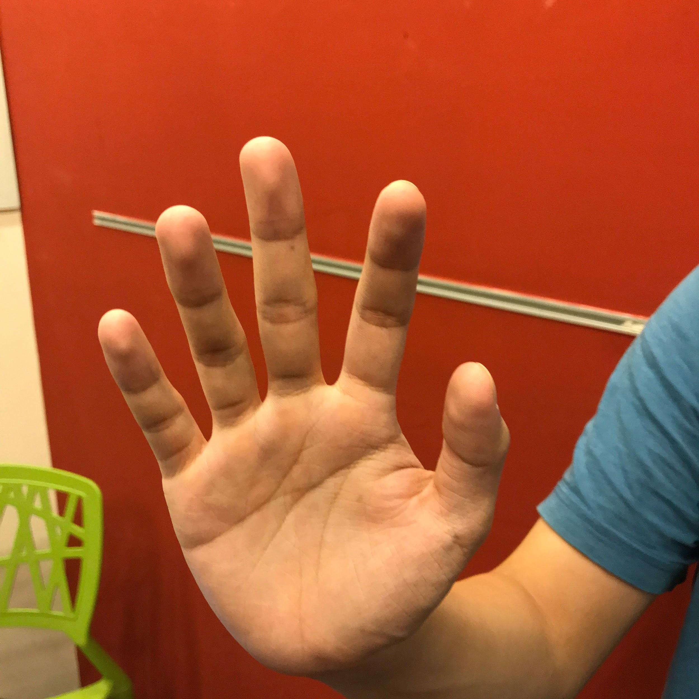
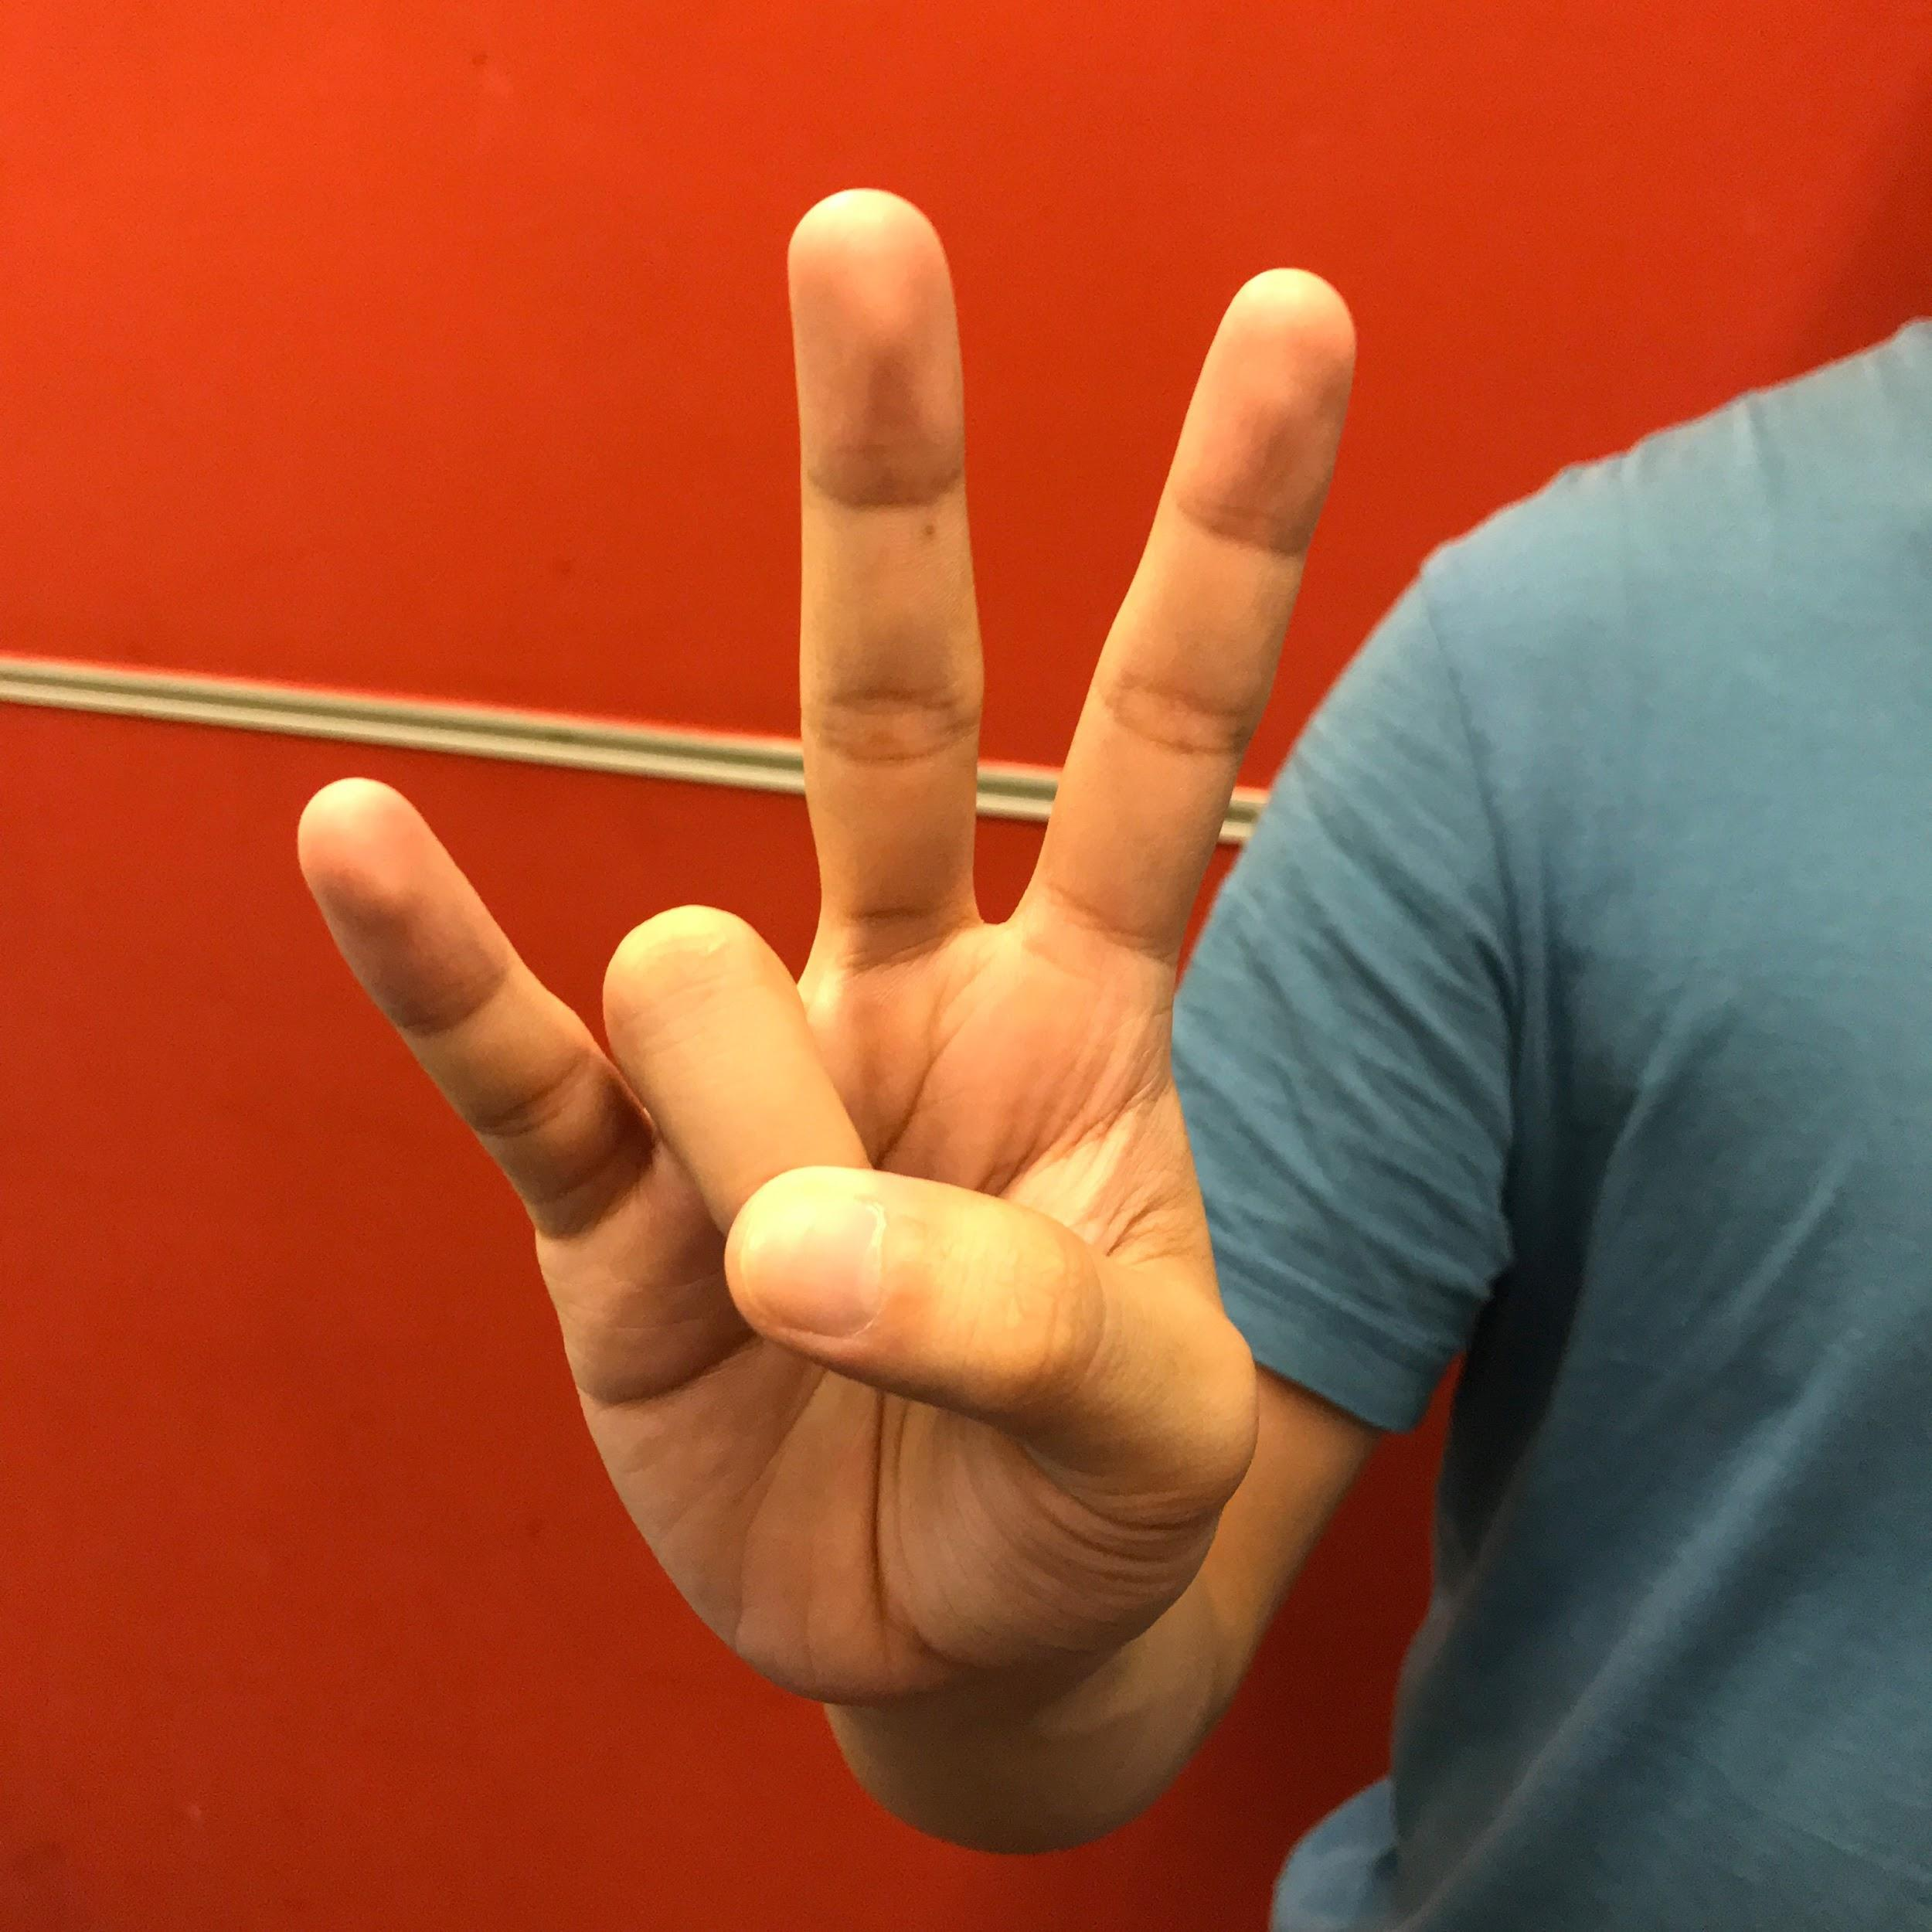
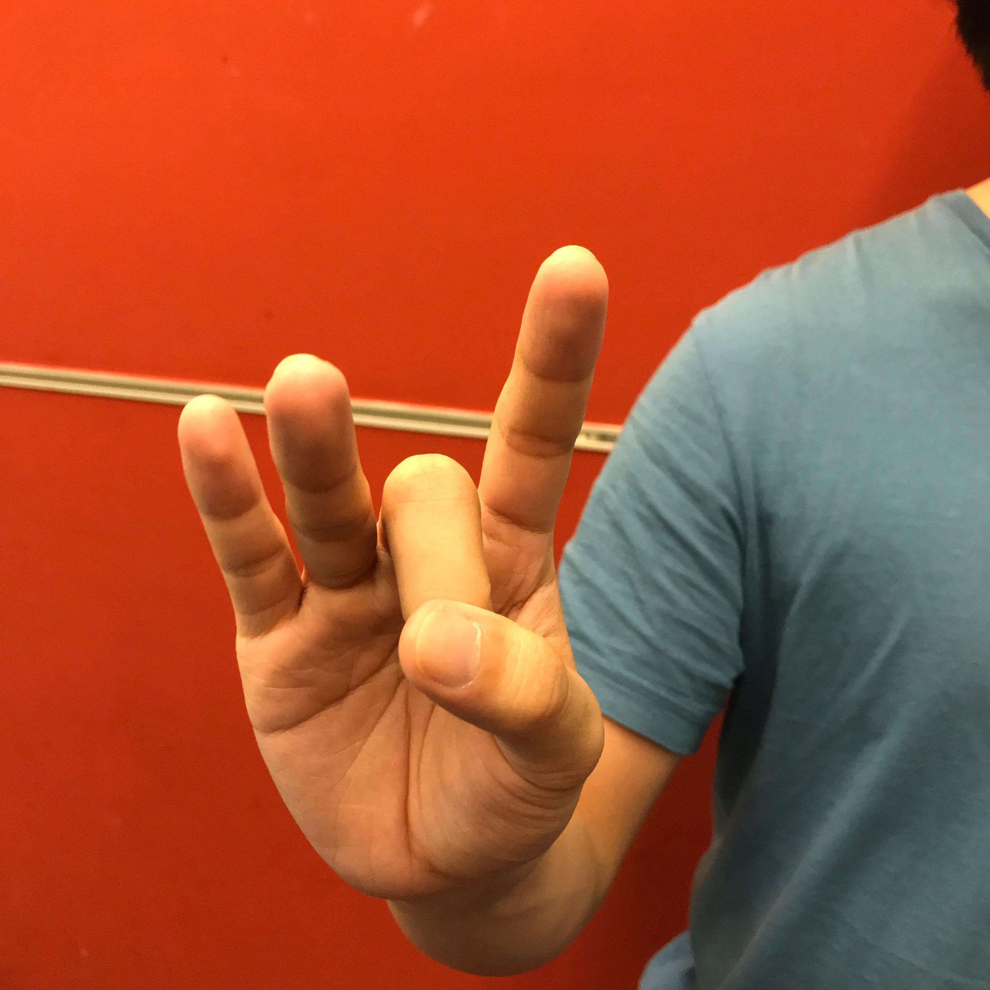
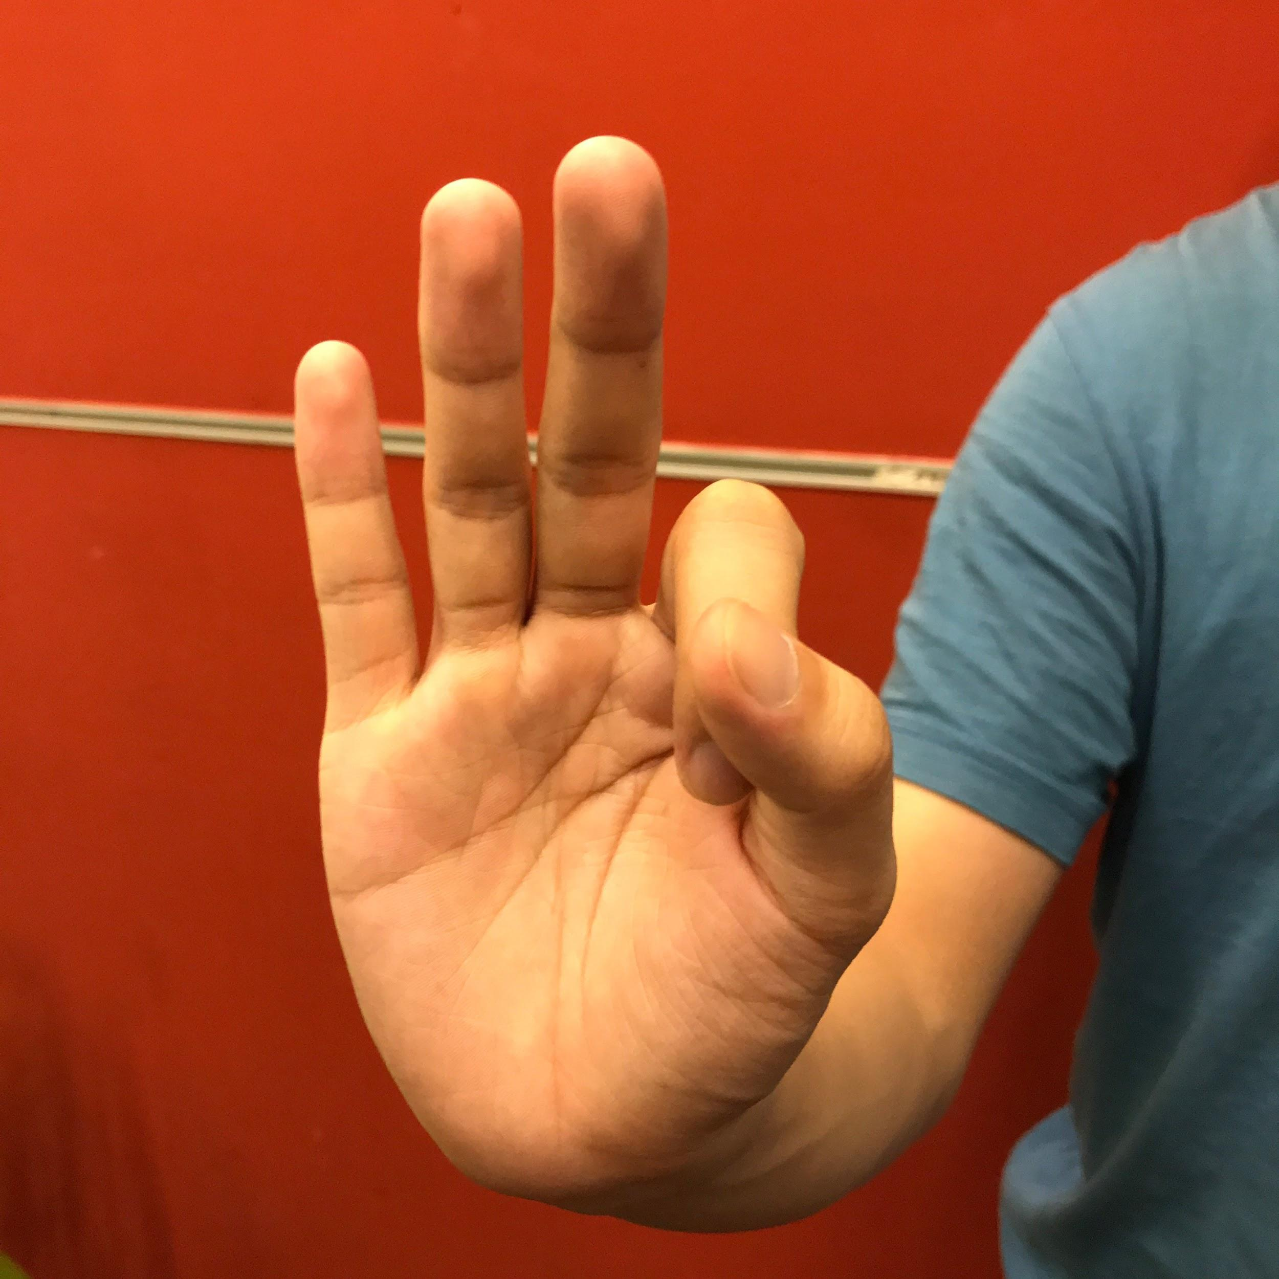
data

Slide 16
參考論文
J. Redmon, A. Farhadi, "Yolov3: An incremental improvement", CoRR, vol. abs/1804.02767, 2018.
Pigou, L., Dieleman, S., Kindermans, P.J.: Sign Language Recognition Using Convolutional Neural Networks. In: ECCV ChaLearn Workshop on Looking at People (2014)

Slide 17
THE END

